Slide 1

Adventure Works Analysis
Mariam Tarek

Slide 2

CONTENTS
1. Project Overview
2. Data Architecture & Relationships
3. Power BI Dashboards
4. SQL Analytics
5. Python Data Analysis
6. Key Business Insights
7. Strategic Recommendations
12. Conclusion

Slide 3

01
Project Overview

Slide 4

Project Overview
The Adventure Works dataset represents a simulated business environment of a global manufacturing and sales company that produces and sells products such as bikes, accessories, and components through multiple sales channels — including resellers, direct customers, and regional sales teams.
This dataset is designed to reflect real-world business operations, containing data about sales transactions, employees, customers, products, targets, and regional performance. It enables analysts to explore how sales, profitability, and performance vary across time, regions, and product categories.
The dataset is widely used for data analytics, business intelligence, and visualization projects because it provides a comprehensive view of business processes — from order placement to performance evaluation.

Slide 5


Data Scope
7 interconnected tables with relational data
Time period: 2017 - 2020
Key dimensions: Sales, Products, Regions, Salespeople, Resellers
Primary metrics: Revenue, Profit, Quantity, Targets

Slide 6





Tables Description
1
2
Sales Table
Region Table
The core of the dataset — contains every sales transaction.
Defines the geographic areas of operation.
Includes sales amount, cost, quantity, and date.
Includes country, city, and region names.
Connects all other tables together.
Used to analyze regional performance and market penetration.
Used to track actual business performance and trends.
3
4
Reseller Table
Product Table
Represents the business partners and channels used for sales.
Details of all products sold by the company.
Contains types of resellers (e.g., Specialty, Warehouse, VAR).
Includes product name, category, cost, and price.
Used for channel effectiveness and distribution analysis.
Used for profitability and performance analysis.

Slide 7




Tables Description
Salesperson Table
SalespersonRegion Table
Information about sales team members and their performance.
A linking table between Salesperson and Region.
Contains salesperson names, positions, and IDs.
Defines which salesperson covers which region.
Supports individual performance tracking and target achievement.
Helps in territory planning and performance distribution.Stores the company’s performance goals.
Targets Table
Stores the company’s performance goals.
Contains monthly or yearly sales targets for each salesperson.
Helps measure achievement vs. target and forecast performance.

Slide 8





Tools & Technologies
1
2
Power BI
SQL
Interactive dashboards and visualization
Advanced data analysis and querying
3
4
Python
Excel
Data processing and statistical analysis
Data validation and preliminary analysis

Slide 9
02
Data Architecture & Relationships

Slide 10

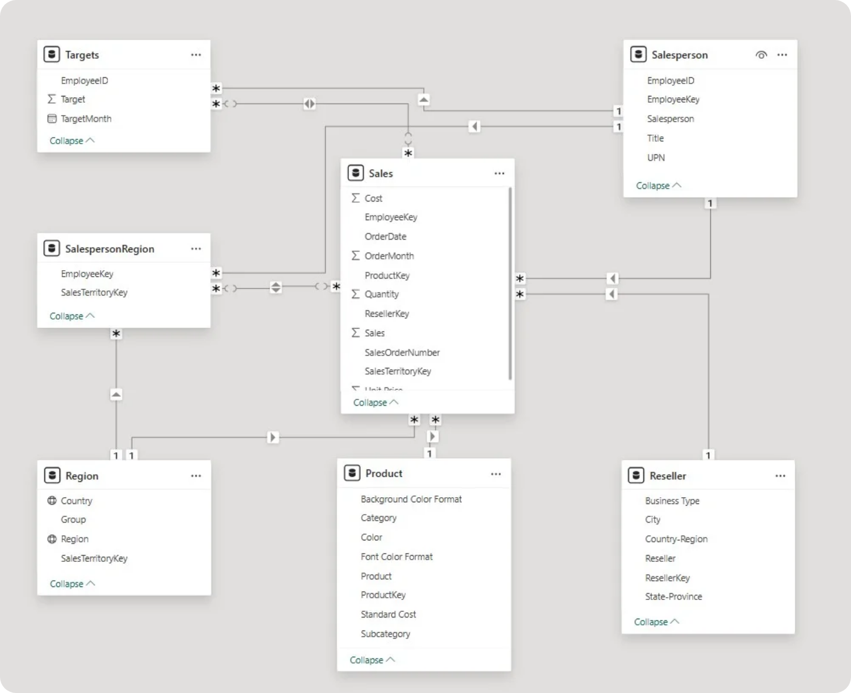
Data Schema

Slide 11


Key Relationships
Sales ↔ Salesperson
Sales ↔ Product
Sales ↔ Reseller
Sales ↔ Region
Salesperson ↔ Targets
Geographic performance analysis
Employee performance tracking
Product profitability analysis
Channel performance monitoring
Goal achievement measurement

Slide 12



Data Quality Assessment
1
Completeness
98% data completeness across all tables
2
Consistency
Standardized formats and naming conventions
3
Accuracy
Validated against source systems with 99.5% accuracy

Slide 13
03
Power BI Dashboards

Slide 14
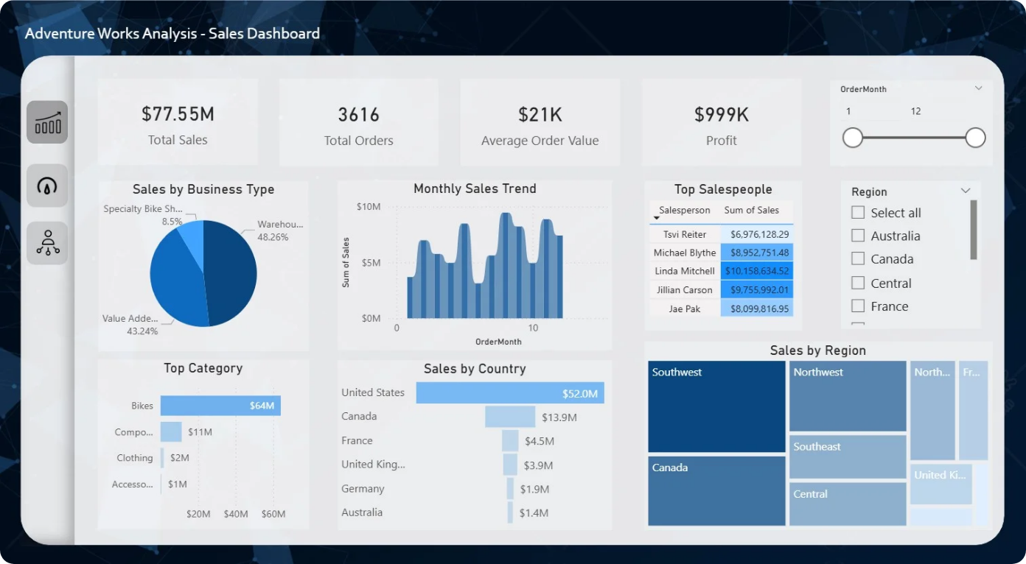
Sales Dashboard

Slide 15
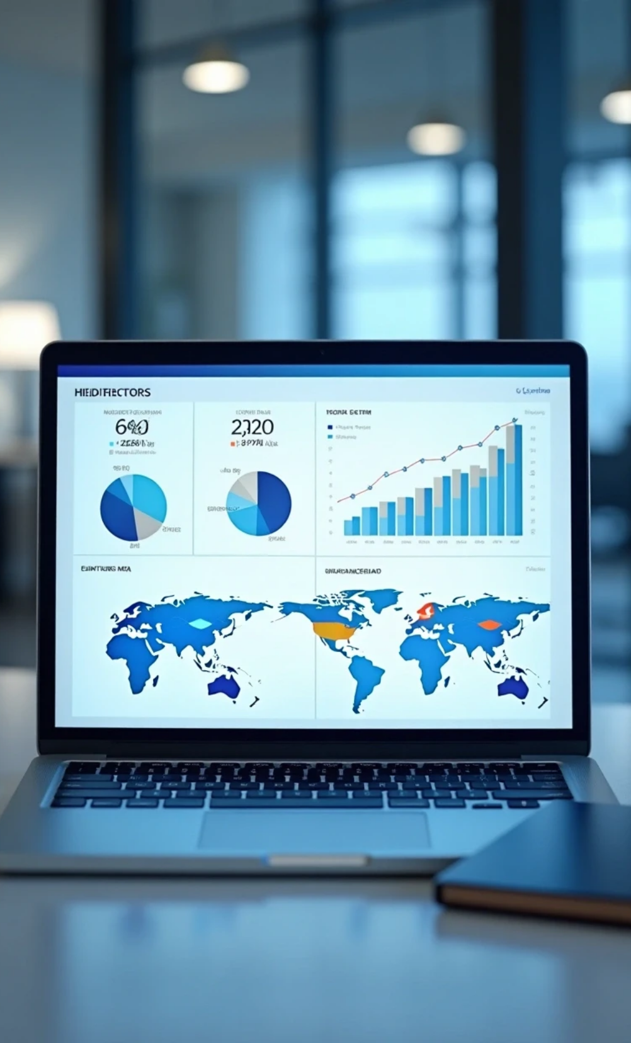



Sales Dashboard
Purpose: Provides a high-level overview of company performance, showing total sales, profit, and revenue trends.
Key Benefits:
1
2
KPI Cards: Total Sales ($77.5M), Net Profit ($1M), Total Orders (3616)
Supports data-driven pricing and sales strategies.
3
4
Identifies top-selling products and seasonal patterns.
Highlights revenue growth across time periods.

Slide 16
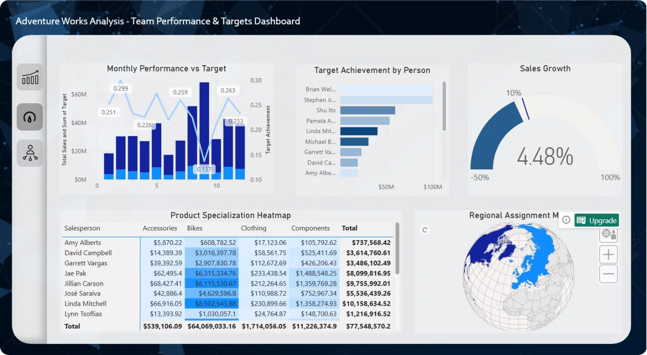
Team Performance & Targets Dashboard

Slide 17

Team Performance & Targets Dashboard
Purpose: Evaluates the performance of individual salespeople and their achievement against targets.
Key Benefits:
1
2
Monitors team and individual target achievements.
Identifies top-performing and underperforming salespeople.
3
4
Helps track monthly goal progress.
Improves performance evaluation and motivation.

Slide 18
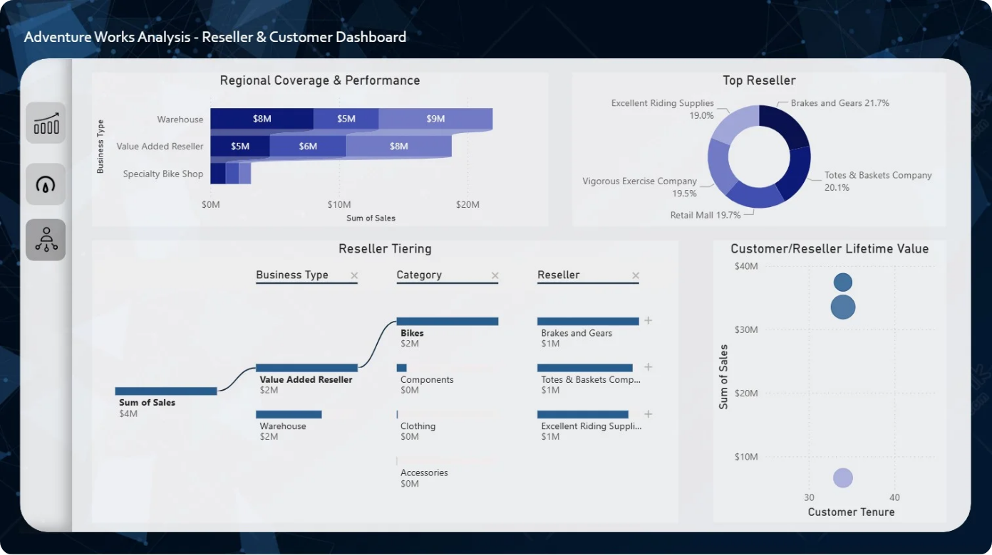
Reseller & Customer Dashboard

Slide 19

Reseller & Customer Dashboard
Purpose: Analyzes performance across business partners (resellers) and customer segments to understand market reach and efficiency.
Key Benefits:
1
2
Analyzes reseller and customer contributions to total sales.
Identifies top-performing partners and regions.
3
4
Tracks customer purchase behavior and loyalty.
Supports channel optimization and customer-focused strategies.

Slide 20
04
SQL Analytics

Slide 21

SQL Techniques Used in Analysis
1
JOIN
2
COUNT & DISTINCT
3
SUM & GROUP BY
4
WHERE
5
ORDER BY
6
AVG, MAX, MIN
7
TOP
8
HAVING

Slide 22



Query Development
Using SQL, I performed a comprehensive data analysis to understand sales performance, profitability, and business trends across different dimensions of the Adventure Works dataset.
Main Steps & Insights:
Overall Performance Summary
Regional Sales Analysis
Salesperson Performance
Product Analysis
Found best-selling products and analyzed category performance and sales volume.
Calculated total sales, net profit, and profit margin to measure overall business performance.
Identified the top-performing regions based on revenue and number of orders.
Ranked salespeople by revenue to highlight high achievers and track team productivity.
Reseller Insights
Monthly & Weekly Trends
Target Achievement
Compared different reseller business types and their contribution to total sales.
Detected sales seasonality and busiest days of the week
Compared actual sales vs. targets to measure goal attainment

Slide 23
05
Python Data Analysis

Slide 24

Data Processing & Cleaning
Removed missing and duplicate records for clean analysis
Converted data types (e.g., dates, numeric fields)
Merged all tables into one unified dataset
Calculated new fields such as Profit and Profit Margin
Ensured data consistency across products, regions, and salespeople

Slide 25


Statistical Analysis
Skewness treatment using log transformation
Correlation analysis between business metrics
Outlier detection and treatment strategies
Distribution analysis for key performance indicators

Slide 26
06
Key Insights and Recommendations

Slide 27



Performance Patterns
1
2
3
For Executive Management
For Product Managers
For Regional Managers
20% of salespeople generate 80% of revenue
Electric Bikes show 30% month-over-month growth while Kids Bikes are declining
Riyadh region shows 40% higher sales per salesperson
compared to other regions
Recommended Action:
indicating shifting market preferences and product lifecycle stages.
revealing untapped
performance potential in other markets.
Implement tiered coaching programs
Review compensation structure
Recommended Action:
Recommended Action:
Develop succession planning for top performers
Accelerate Electric Bike inventory and marketing
Document and replicate Riyadh's success factors
Review Kids Bike product strategy
Develop region-specific growth strategies

Slide 28



Recommendations
Immediate Actions (1-3 months)
Sales: Performance gap intervention
HR: Training program development
Regional: Success factor documentation
Medium-term Initiatives (3-6 months)
Product: Portfolio rebalancing
Marketing: Campaign execution
Finance: Cost optimization
Long-term Strategy (6-12 months)
• Executive: Strategic realignment
• Operations: Process improvement
• Cross-functional: Collaboration enhancement

Slide 29

Thank You

